Slide 1
Computer Organization
TOPIC 2.0 – Computer organization
TOPIC 2
2.1.9 – 2.1.10: Binary Representation

Slide 2

REVIEW REVIEW REVIEW REVIEW REVIEW REVIEW
THE WARM-UP QUESTION
Compare and contrast a Command Line Interface (CLI) with a Graphical User Interface (GUI)

Slide 3
REVIEW REVIEW REVIEW REVIEW REVIEW REVIEW
THE WARM-UP ANSWER
CLI: Quick, Easy to implement, Lack of easily accessible menus, difficult to work with, keyboard only
GUI: Easy to understand, takes more time to develop, actions often take longer, mouse and keyboard support

Slide 4
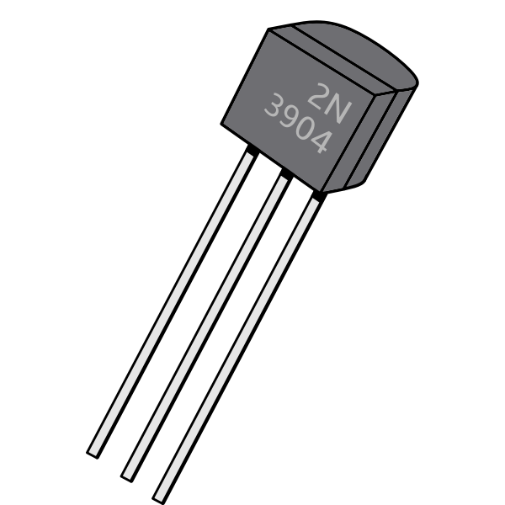
TOPIC 2.1.9 – BIT AND BYTE
Bits and Bytes
Bit – short for Binary Digit
Either a 0 or a 1
The basic data storage of all computers
Represents a physical transistor being turned on (1) or off (0)
Strings of bits put together represent all data in a computer
By putting 8 of these bits together we create a byte, which is the most common way of referring to computer space
Bits are represented with a lowercase b
Bytes are represented with a capital B
1B = 8b

Slide 5
TOPIC 2.1.9 – BIT AND BYTE
Bits and Bytes
One byte can store one ‘character’
One character being one letter, digit of a number, or punctuation mark
We do this using the ASCII scheme – more to come later

Slide 6
TOPIC 2.1.9 – DECIMAL NUMBER SYSTEM
DECIMAL NUMBER SYSTEM
As humans, we keep track of numbers in base 10
Also known as decimal
In decimal, we have ten digits, 0 – 9
Why might we have decided to use decimal?
For each place value, we multiply the digit there by the place value
Ex: 453 = (4 * 100) + (5 * 10) + (3 * 1)
453 = (4 * 10²) + (5 * 10¹) + (3 * 10⁰)

Slide 7
TOPIC 2.1.9 – BINARY NUMBER SYSTEM
BINARY NUMBER SYSTEM
Computers use binary, or base 2
For each place value, we multiply the digit there by the place value
Ex: 10011₂ = (1 * 16) + (0 * 8) + (0 * 4) + (1 * 2) + (1 * 1) = 19₁₀
10011₂ = (1 * 2⁴) + (0 * 2³) + (0 * 2²) + (1 * 2¹) + (1 * 2⁰) = 19₁₀

Slide 8
TOPIC 2.1.9 – BINARY NUMBER SYSTEM
BINARY CONVERSIONS
Binary to Decimal
Multiplier (Power of two) | 2⁶ | 2⁵ | 2⁴ | 2³ | 2² | 2¹ | 2⁰
Multiplier | 64 | 32 | 16 | 8 | 4 | 2 | 1
Digit | 1 | 0 | 1 | 1 | 0 | 1 | 1
10011₂ = (1 * 64) + (0 * 32) + (1 * 16) + (1 * 8) + (0 * 4) + (1 * 2) + (1 * 1) = 91₁₀

Slide 9
TOPIC 2.1.9 – BINARY NUMBER SYSTEM
BINARY CONVERSIONS
Read the remainders from bottom to top
69₁₀ = 1000101₂
Decimal to Binary
69/2 = 34 with remainder 1
34/2 = 17 with remainder 0
17/2 = 8 with remainder 1
8/2 = 4 with remainder 0
4/2 = 2 with remainder 0
2/2 = 1 with remainder 0
1/2 = 0 with remainder 1

Slide 10
TOPIC 2.1.9 – BINARY NUMBER SYSTEM
NEGATIVE NUMBERS IN BINARY
Negative numbers in binary are represented in two’s complement
To convert a number to the negative version of itself
First, we invert each digit of the number
56₁₀ in binary (represented as a byte) = 00111000₂
Inverted, 11000111₂
Second, we add a 1 to this number
11001000₂
This exact same method can be used to invert the number back to positive value

Slide 11
TOPIC 2.1.9 – BINARY NUMBER SYSTEM
NEGATIVE NUMBERS IN BINARY
In two’s complement, the largest positive number we can store in a byte is no longer 11111111₂ = 255₁₀ = 2⁸ – 1
It is now 01111111₂ = 127₁₀ = 2⁷ – 1, since the first bit in the byte is reserved to indicate the sign of the number
The largest negative number that can be represented is 11111111₂ = -1₁₀
The smallest positive number that can be stored is 00000001₂ = 1₁₀
The smallest negative number that can be stored is 10000000₂ = -128₁₀

Slide 12
TOPIC 2.1.9 – HEXADECIMAL
HEXADECIMAL NUMBER SYSTEM
To shorten the visual representation of binary, we can compress it into hexadecimal, or base 16
In hex, we use 16 digits, these being 0-9, and A-F (since we ran out of numbers)
Ex: A4E₁₆ = (A * 256) + (4 * 16) + (E * 1) = 2638₁₀
A4E₁₆ = (10 * 16²) + (4 * 16¹) + (14 * 16⁰) = 2638₁₀

Slide 13
TOPIC 2.1.9 – HEXADECIMAL
HEXADECIMAL CONVERSIONS
Hex to Decimal
Multiplier (Power of sixteen) | 16³ | 16² | 16¹ | 16⁰
Multiplier | 4096 | 256 | 16 | 1
Digit | F (15) | 2 | 0 | A (10)
F20A₁₆ = (15 * 4096) + (2 * 256) + (16 * 0) + (1 * 10) = 61962₁₀

Slide 14
TOPIC 2.1.9 – HEXADECIMAL
HEX CONVERSIONS
Read the remainders from bottom to top
1051₁₀ = 41B₁₆
Decimal to Hex
1051/16 = 65 with remainder 11 (B)
65/16 = 4 with remainder 1
4/16 = 0 with remainder 4

Slide 15
TOPIC 2.1.10 – DATA REPRESENTATION
Representing data
Because everything in a computer is binary, there’s only two possible values it can represent
In order to represent more complex data we string these binary numbers together
The number of bits data is given determines how many different values it can possibly represent
8 bits = 2⁸ values = 256 values, 16 bits = 2¹⁶ values = 65536 values

Slide 16
TOPIC 2.1.10 – DATA REPRESENTATION
DATA - INTEGERS
Integers are typically represented using two’s complement (from earlier in the slides)
The number of bits an integer is given determines what its maximum value is
8 bits -> 2⁸ / 2 – 1 = 127 maximum value, -(2⁸ / 2) = -128 minimum value
32 bits -> 2³² / 2 – 1 = 2,147,483,647, maximum value, -(2³² / 2) = -2,147,483,648

Slide 17
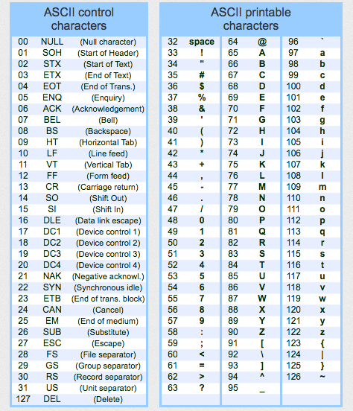
TOPIC 2.1.10 – DATA REPRESENTATION
DATA - CHARACTERs
ASCII – the American Standard Code for Information Interchange
Character encoding scheme based on English alphabet used to represent text on computers
Each letter is given a value from 0 to 127
2?
Contains letters, digits, punctuation, and some system characters
What’s a potential issue with ASCII?

Slide 18
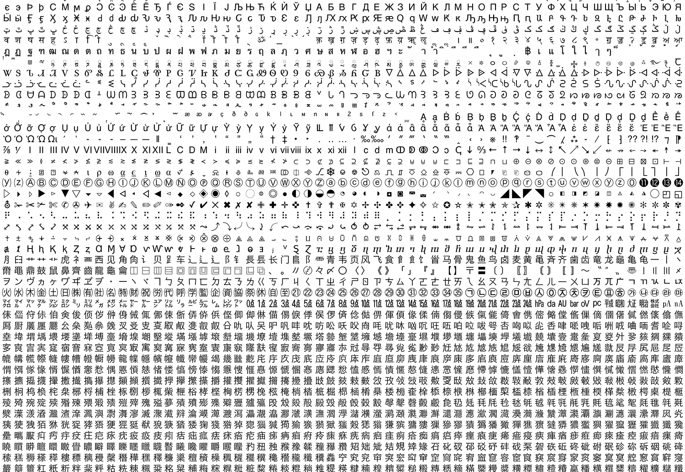
TOPIC 2.1.10 – DATA REPRESENTATION
DATA - CHARACTERs
In cases where ASCII just isn’t enough, we use Unicode
UTF-8 is an 8 bit Unicode encoding that is ‘backwards compatible’ with ASCII
UTF-16 is a 16 bit encoding scheme
UTF-32 is a 32 bit encoding scheme
This scheme actually only needs 21 bits, as we are nowhere close to having 2³² characters to encode
Unicode also has support for emojis

Slide 19
TOPIC 2.1.10 – DATA REPRESENTATION
DATA - STRINGS
Strings are simply the combination of many characters
How many bits does it take to store an average word?
Some programming languages lack a built in ‘String’ data type
Instead, strings are just arrays of characters
Example: C
This is how all programming languages handle strings on the backend, but most still provide a more convenient data type to use it

Slide 20
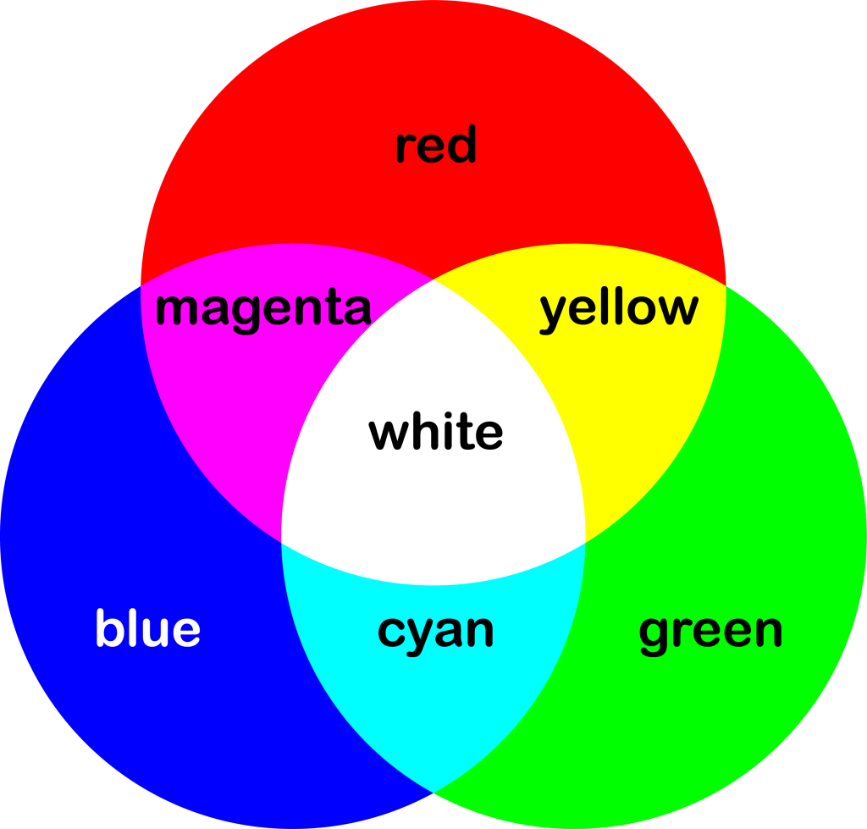
TOPIC 2.1.10 – DATA REPRESENTATION
DATA - COLOR
Even the visuals on our computers must be represented using binary data
The screen is a 2D grid of pixels with dimensions such as 1920x1080
Each pixel has three lights that merge to form visible color
Red, Green, and Blue (RGB)

Slide 21
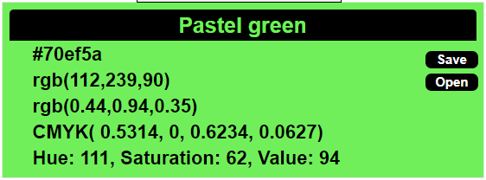
TOPIC 2.1.10 – DATA REPRESENTATION
DATA - COLOR
Each color is represented by two hexadecimal values
Ex: R:70, G: EF, B: 5A
Ex: R: 98, G: 239, B: 90
How many bits does each color get?
How many bits does it take to represent all three colors?
The larger the number, the more of that color the pixel will have
Use this website to try and see what values you have to give the sliders to create the same color
cknuckles.com/rgbsliders.html

Slide 22




TOPIC 2.1.10 – DATA REPRESENTATION
COLOR TESTING
Try and see what values get these colors!

Slide 23

TOPIC 2.0 – computer organization
Vocab to remember
Bit
Byte
Two’s Complement
ASCII
Unicode
RGB
String
Hexadecimal

